Slide 1
SQLMAP Pen-Testing
Colin Glory Information Assurance Fall 2022

Slide 2
The Scenario
SQLmap is an open-source tool used in penetration testing to detect and exploit SQL injection flaws. SQLmap automates the process of detecting and exploiting SQL injection. SQL Injection attacks can take control of databases that utilize SQL. In this case, we will be using Kali to attack Metasploitable2. The easiest way to get a target machine is to use Metasploitable 2, which is an intentionally vulnerable Ubuntu Linux virtual machine that is designed for testing common vulnerabilities.
A scenario for this project can be a hacker wants to hack into an Amazon database and access user’s passwords.

Slide 3
IT Assets Kali
Kali Linux is a Debian-derived Linux distribution designed for digital forensics and penetration testing. It is maintained and funded by Offensive Security.
Download Link: https://www.virtualbox.org/wiki/Downloads
Requirements:
2 GB of RAM.
20 GB of disk space.
Broadband internet connection.
High-definition graphics card and monitor.
Broadband internet connection.
VirtualBox Settings: Use the Virtual Box “Internal Network / intnet” adapter setting for attacker/victim machines to communicate with each other.
Static IP: 192.168.106.25

Slide 4
IT Assets Metasploitable2
The easiest way to get a target machine is to use Metasploitable 2, which is an intentionally vulnerable Ubuntu Linux virtual machine that is designed for testing common vulnerabilities.
Download Link: https://sourceforge.net/projects/metasploitable/
Requirements:
1 GB of RAM (2 GB is recommended)
VirtualBox Settings: Use the Virtual Box “Internal Network / intnet” adapter setting for attacker/victim machines to communicate with each other.
Static IP: 192.168.106.51

Slide 5
Videos Used for Guidance
https://www.youtube.com/watch?v=IGIA7eSMxs8&t=647s
https://www.youtube.com/watch?v=-q8Jj4aAWYw&t=236s

Slide 6

SQLMAP
sqlmap is an open source penetration testing tool that automates the process of detecting and exploiting SQL injection flaws and taking over of database servers.
Once it detects one or more SQL injections on the target host, the user can choose among a variety of options to perform an extensive back-end database management system fingerprint, retrieve DBMS session user and database, enumerate users, password hashes, privileges, databases, dump entire or user’s specific DBMS tables/columns, run his own SQL statement, read specific files on the file system and more.

Slide 7
Virtual-Box Setup Tutorial
a. Go to https://www.virtualbox.org/wiki/Downloads
b. Select
c. Let it download, then run the program when finished
d. When VirtualBox opens, select next, next again, next, yes, then install
e. If you get asked to download device software, press install.
f. You may now run VirtualBox

Slide 8
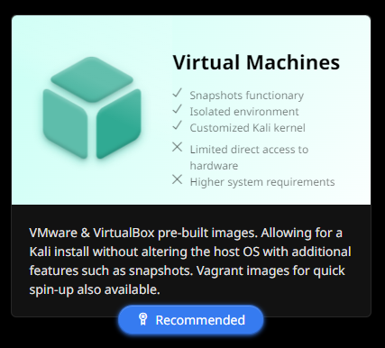
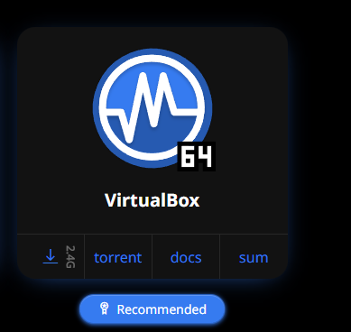
Kali Setup
Go to https://www.kali.org/get-kali/ then Select ⇒
Since my system is 64 bit, I will be choosing 64 bit
Select the download button for your selection ⇒
Give it a few minutes to download

Slide 9
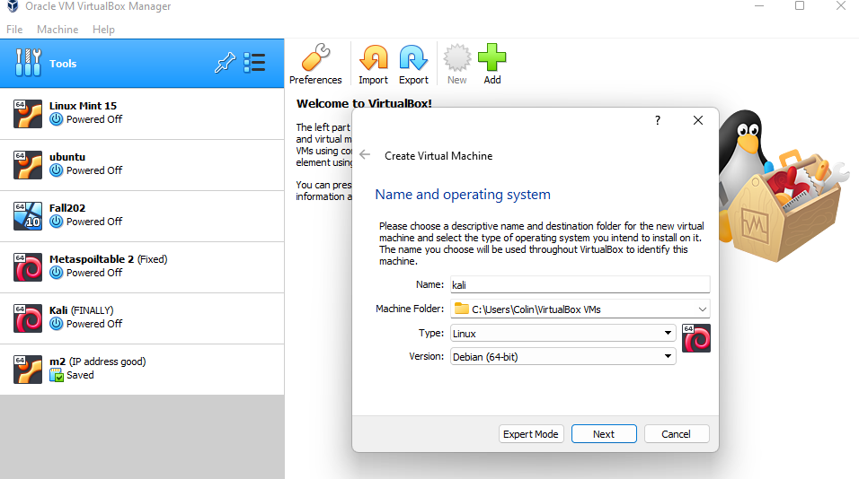
Kali Cont
Go to your downloads, then right click on the kali download zipped file, then extract to whatever folder you want
Next, load up Virtual Box
Select Tools, then New
Name: Kali
Type: Linux
Version Debian 64 bit, then select next

Slide 10
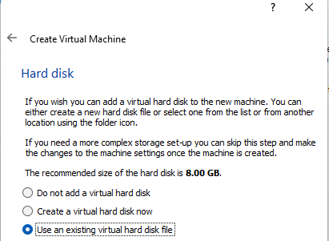


Kali Cont
For the memory size, it depends on your system. For me i chose around 8gb due to having 32gb of RAM
For the hard disk, select use an existing virtual hard disk ⇒
Select the folder at the bottom of the screen then press add ⇒
Go to the unzipped folder of Kali that we previously unzipped
Select ⇒

Slide 11
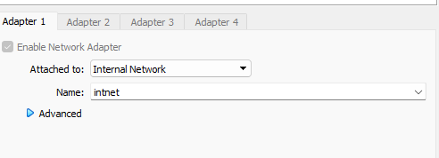
Kali Cont
After selecting the file, press open
Now choose that file in the hard disk area and select create
For Kali settings, make sure the network adapter 1 is enabled and select Internal Network ⇒
You may now run Kali

Slide 12
Kali cont
Let Kali run. It may run some installations, if it does then let it finish. Once you get to the login screen, the credentials are as follows:
User: kali
Password: kali
Open the terminal once you are logged in

Slide 13

Metasploitable2 Setup
Go to https://sourceforge.net/projects/metasploitable/ then select download
Let it download. Go to the zipped file when it is finished, then unzip it to your desired folder.
Next, load up Virtual Box
Select Tools, then New
Name: Metasploitable2
Type: Linux
Version Debian 64 bit, then select next

Slide 14
Metasploitable2 cont
For the memory size, it depends on your system. For me i chose around 8gb due to having 32gb of RAM
For the hard disk, select use an existing virtual hard disk ⇒
Select the folder at the bottom of the screen then press add ⇒
Go to the unzipped folder of Kali that we previously unzipped
Select ⇒
Now hit create

Slide 15
Metasploitable2 cont
For the network settings, make sure the network adapter 1 is enabled and select Internal Network ⇒
You may now run Metasploitable2

Slide 16
Metasploitable2 cont
Let Metasploitable2 run. It may run some installations, if it does then let it finish. Once you get to the login screen, the credentials are as follows:
User: msfadmin
Password: msfadmin
This vm will look different compared to Kali

Slide 17
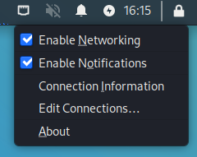

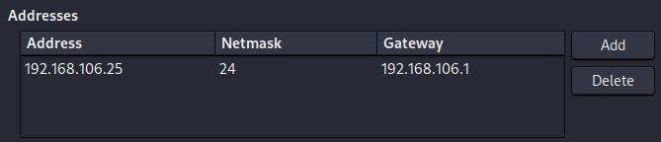
Setting Up Static IP Addresses
On Kali, right click the icon to the left of the volume button, then select edit connections ⇒
Now select Wired Connection 1 then press the settings button at the bottom. Go to IPV4 settings and press the add button. Enter as follows:

Slide 18
Setting Up Static IP Addresses
Once the information is entered in, press save at the bottom and load a new terminal window. In the window type ifconfig to see if your address has changed.

Slide 19

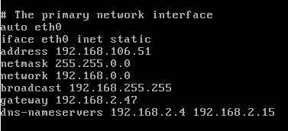
Setting Up Static IP Addresses
Now for Metasploitable2. You may type ifconfig to view your current network settings and IP. To change the address, you must type sudo nano /etc/network/interfaces
Once you have entered the file, you will see information. You will change the section that starts with to ⇒
Cntrl + O then cntrl X to save and exit

Slide 20
Setting Up Static IP Addresses
Now type ifconfig. You will now see the updated ip address
Now you should be able to ping each machine.
To ping kali from Meta type Ping 192.168.106.25 -c4
To ping from Kali to Meta would be ping 192.168.106.51 -c4

Slide 21
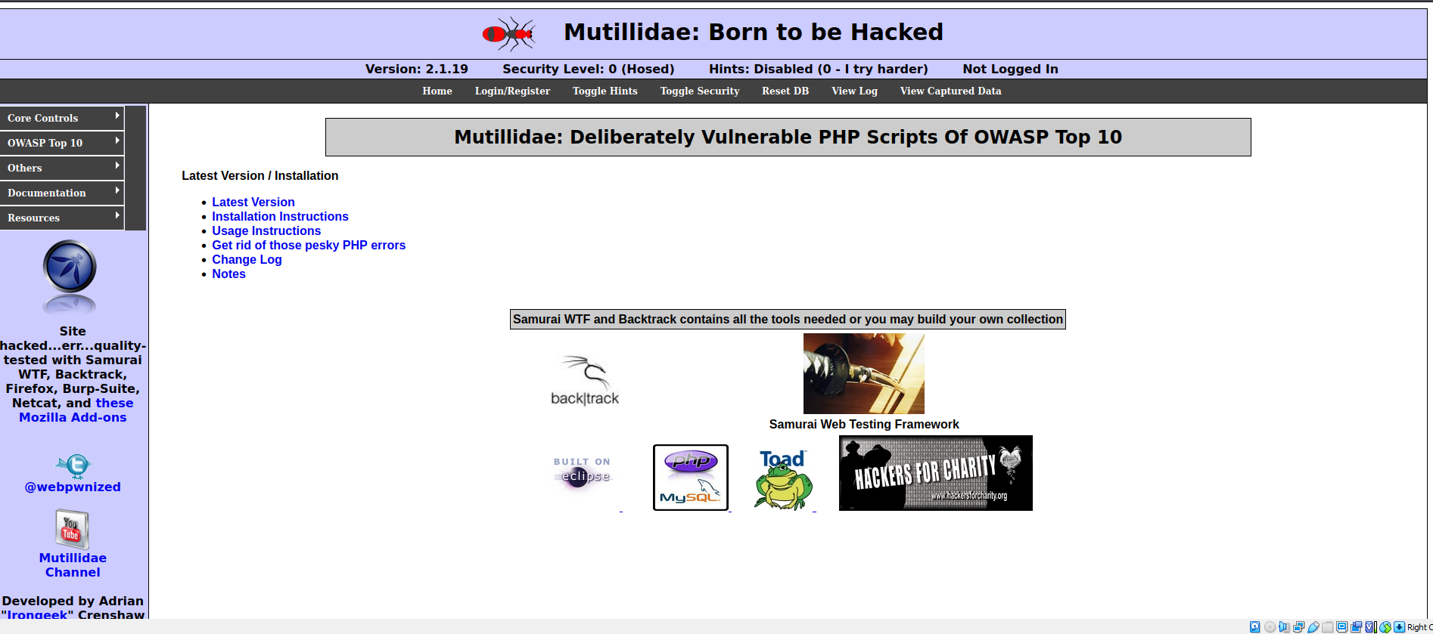
Setting up apache2 server
You will need to set up a web server on the Metasploitable machine
You can type clear in the terminal to clean up the screen. To install apache2, type in the terminal sudo apt-get install apache2
This will install the webserver. To start the web server type in the command sudo /etc/init.d/apache2 restart
Now on the Kali machine. Go to firefox, then type 192.168.106.51 in the search bar
You are now ready to
Start the attack

Slide 22

Quick fix before attack
On the Metasploitable2 machine type the following:
Change dbname to owasp10, then CRTL O to write out and CTRL X to exit

Slide 23
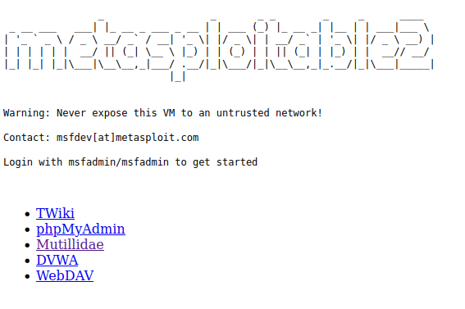


SQLMAP Attack
Finally it is time to attack our victim machine, Metasploitable2. On firefox in Kali, type in Metasploitable 2’s IP Address, 192.168.106.51.
Select the Mutillidae tab⇒
Select OWASP Top 10 , ⇒A1 Injection⇒ SQli Extract Data⇒user info
To make sure the database is working properly, choose Please register here and fill in random information. If you get no errors, the database is set up properly. If you have an error, please check the previous slide.
Go back to the login page and enter in admin for username and something random for the password. You may now hit View Account Details

Slide 24

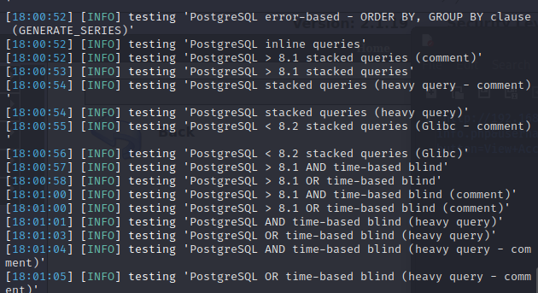
SQLMAP Attack
You will get an error, which is what we want.
Now copy the URL bar:
And now paste it in a notepad on Kali. You will put double quotes around the pasted text:
Copy the updated text and open a new Kali terminal window. In the terminal window type sqlmap -u “paste the new url here”
SQLMAP will now start to run and you will be prompted with Y/n questions. Type Y. SQLMAP will begin tests.

Slide 25
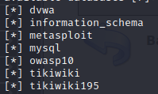
SQLMAP Attack
You will be prompted with this statement.
The username is enough to get us access into the database, so you can press N.
We can now view the databases of Mutillidae. In the terminal type sqlmap -u “paste the new url here” –dbs
Press Y when you get promoted with a question. You will now see the databases

Slide 26
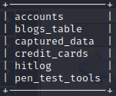
SQLMAP Attack
We can go a step further and view the tables of each database. Let's choose owasp10.
In the terminal type sqlmap -u “paste the new url here” –tables -D owasp10
Once again it will ask you a question, type Y
Here are the tables:

Slide 27
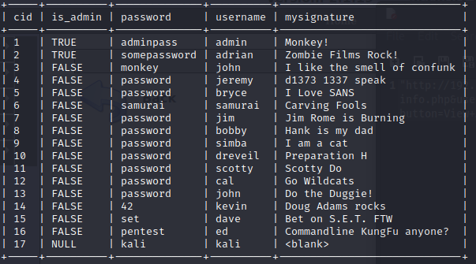
SQLMAP Attack
We can go another step forward and view the contents of the tables
In the terminal type sqlmap -u “paste the new url here” -T accounts –dump
Press Y when the question gets asked
We have accessed their tables! We breached
Their system and can now see all of the login
Information. The attack is done, but you can
Explore this tool to go even further. You
Can try to change table information!

Slide 28
Appendix
a. The first problem I ran into was not knowing how to how the attacker access the victim’s localhost web page. To fix this, you need to follow the apache2 web server steps.
b. The last problem I have dealt with had to do with setting up static ip addresses. I was able to configure Kali’s ip address to my liking, but couldn’t figure out how to do it for Metasploitable’s machine. You must edit the file in /etc/network/interfaces. All steps are provided above.

